Slide 1
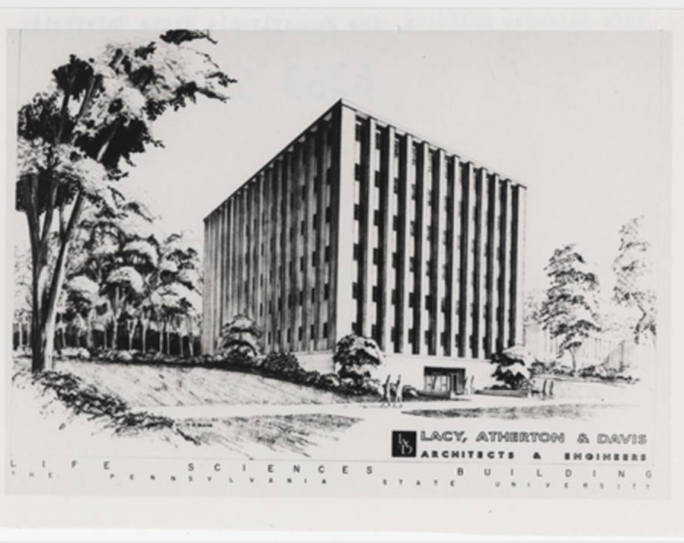
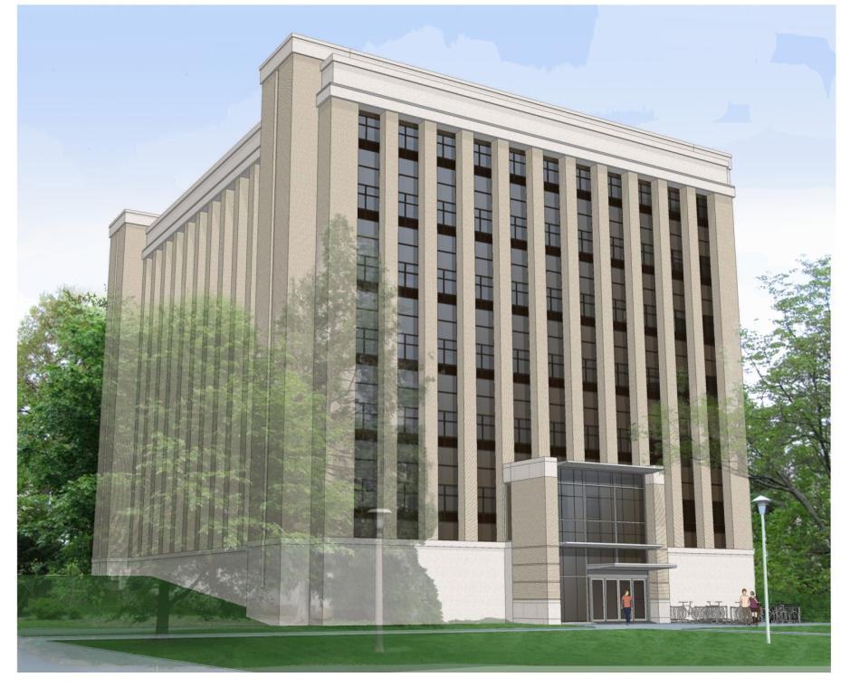
Mueller Laboratory Renovation
By
Mark Jackson
Construction Management
Dr. David Riley, Advisor

Slide 2
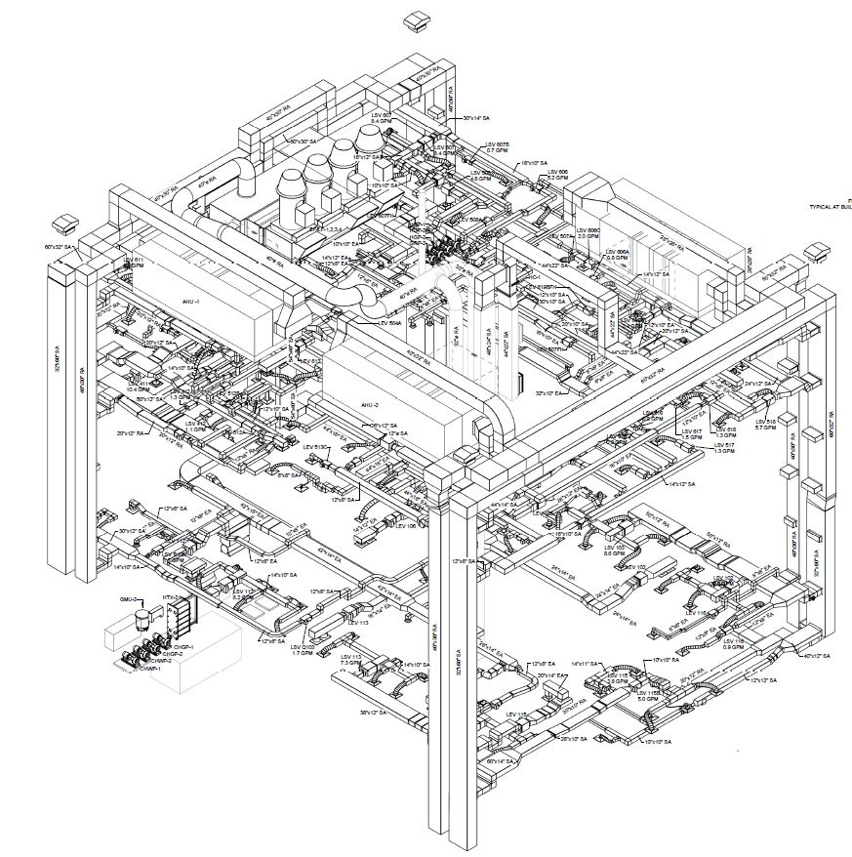
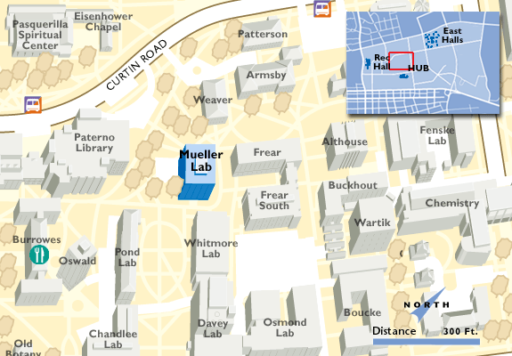
Mueller Laboratory Renovation Presentation Outline: Introduction Breadth topic 1 – Roof Reinforcement Depth topic 1 – Recycling Opportunities Depth topic 2 – Site Logistics Breadth topic 2 – LED Downlights Conclusion
Introduction
Mueller Laboratory Renovation
On PSU University Park campus
$18 million project
Gutting, renovation of 4 of 7 floors
Replacement of outdated HVAC, electrical systems
Scheduled to be completed before 2015 school year

Slide 3
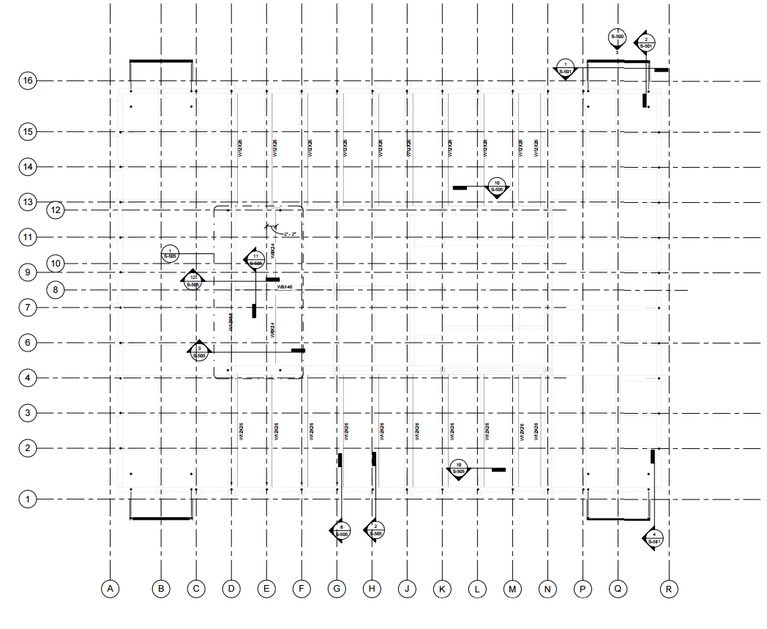
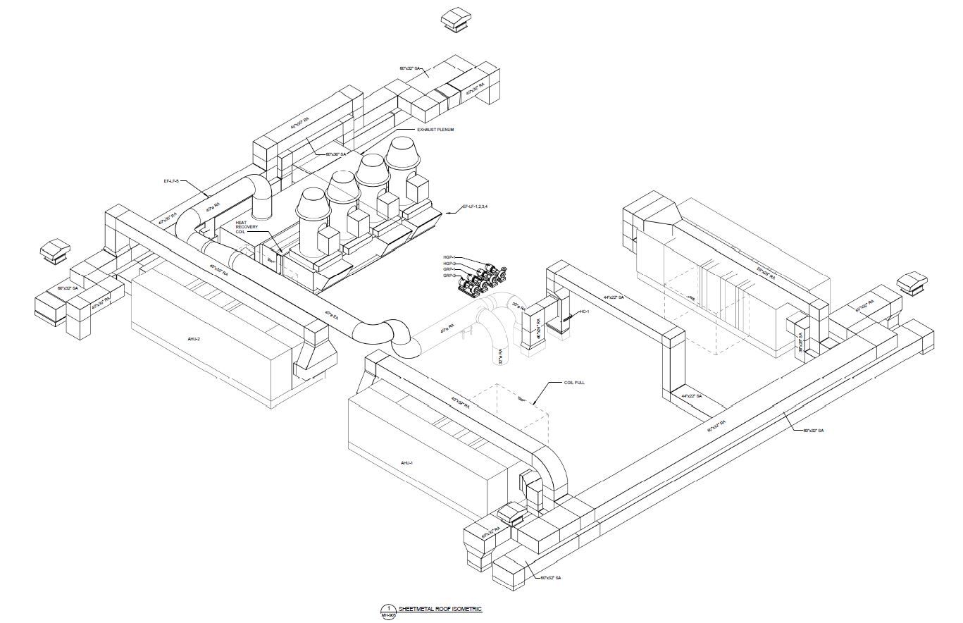
Mueller Laboratory Renovation Presentation Outline: Introduction Breadth topic 1 – Roof Reinforcement Depth topic 1 – Recycling Opportunities Depth topic 2 – Site Logistics Breadth topic 2 – LED Downlights Conclusion
Roof Reinforcement
Reason for Reinforcement

Slide 4
Mueller Laboratory Renovation Presentation Outline: Introduction Breadth topic 1 – Roof Reinforcement Depth topic 1 – Recycling Opportunities Depth topic 2 – Site Logistics Breadth topic 2 – LED Downlights Conclusion
Roof Reinforcement
Reason for Reinforcement
3 new air handling units (with room for a 4th
z
3
3
2
2
1
1

Slide 5
Mueller Laboratory Renovation Presentation Outline: Introduction Breadth topic 1 – Roof Reinforcement Depth topic 1 – Recycling Opportunities Depth topic 2 – Site Logistics Breadth topic 2 – LED Downlights Conclusion
Roof Reinforcement
Reason for Reinforcement
3 new air handling units (with room for a 4th
4 laboratory exhaust fans
z
3
3
2
2
1
1

Slide 6
Mueller Laboratory Renovation Presentation Outline: Introduction Breadth topic 1 – Roof Reinforcement Depth topic 1 – Recycling Opportunities Depth topic 2 – Site Logistics Breadth topic 2 – LED Downlights Conclusion
Roof Reinforcement
10
Under-deck Reinforcing Beams
25 steel beams
Next to existing concrete joists
Underneath existing concrete joists
Hung with bolts off of concrete beams
11
10
12
11
12
10

Slide 7
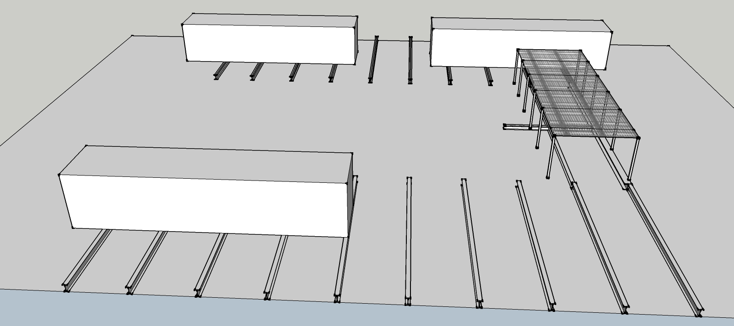
Mueller Laboratory Renovation Presentation Outline: Introduction Breadth topic 1 – Roof Reinforcement Depth topic 1 – Recycling Opportunities Depth topic 2 – Site Logistics Breadth topic 2 – LED Downlights Conclusion
Roof Reinforcement
AHU 1
AHU 2
Problems with Under-Deck Reinforcement
Schedule depends on demolition
Difficulty of overhead work
Constraints on steel placement
Lowered ceiling height
1
2
3
4
Platform posts
AHU 3

Slide 8
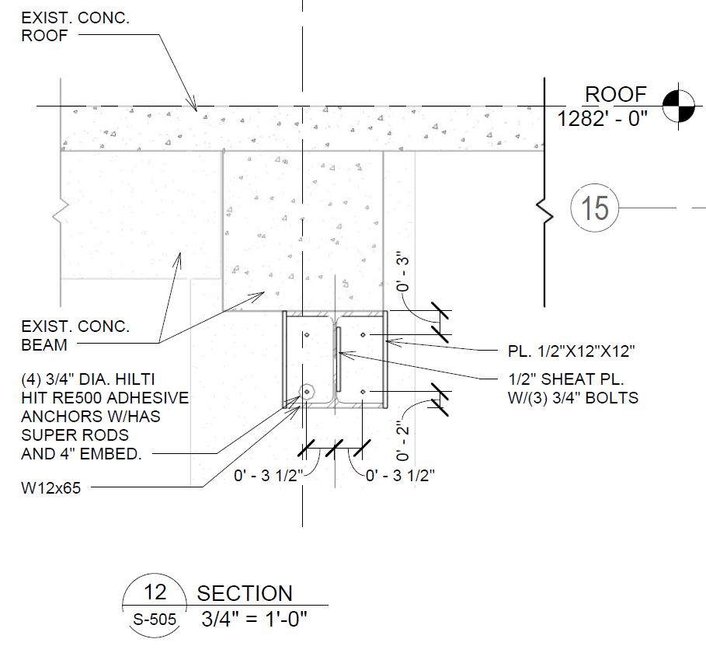
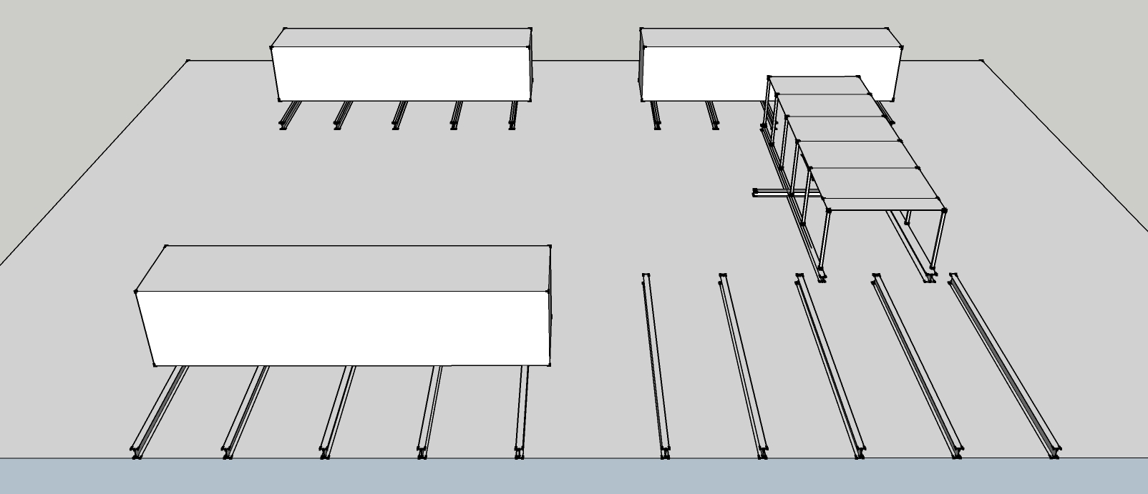
Mueller Laboratory Renovation Presentation Outline: Introduction Breadth topic 1 – Roof Reinforcement Depth topic 1 – Recycling Opportunities Depth topic 2 – Site Logistics Breadth topic 2 – LED Downlights Conclusion
Roof Reinforcement
AHU 1
AHU 2
Advantages to Roof-Top Reinforcement
Does not depend on demolition
No overhead work means safer work, higher quality product
No constraints on steel placement
No lowered ceiling height
1
2
3
4
Platform posts
AHU 3
AHU 1
AHU 2
1
2
3
4
5
Posts on beam
AHU 3

Slide 9
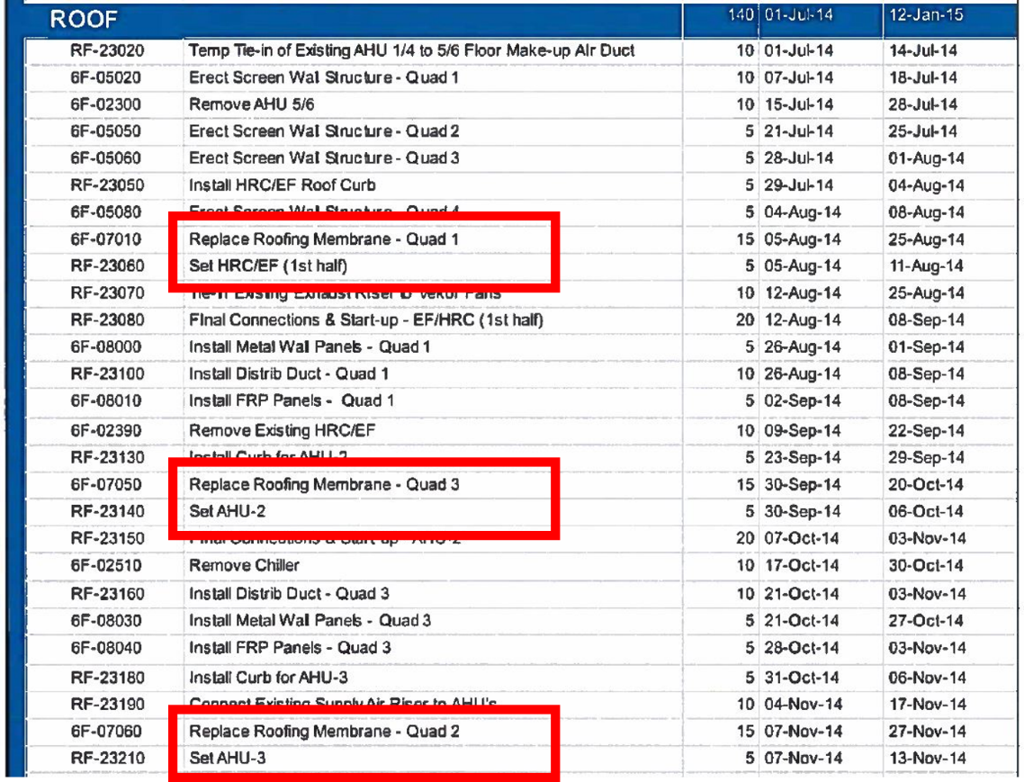
Mueller Laboratory Renovation Presentation Outline: Introduction Breadth topic 1 – Roof Reinforcement Depth topic 1 – Recycling Opportunities Depth topic 2 – Site Logistics Breadth topic 2 – LED Downlights Conclusion
Roof Reinforcement
AHU 1
AHU 2
Roof Waterproofing
Project scope includes membrane roof replacement
Install new roof membrane after steel is in place
1
2
3
4
Platform posts
AHU 3
AHU 1
AHU 2
1
2
3
4
5
Posts on beam
AHU 3

Slide 10
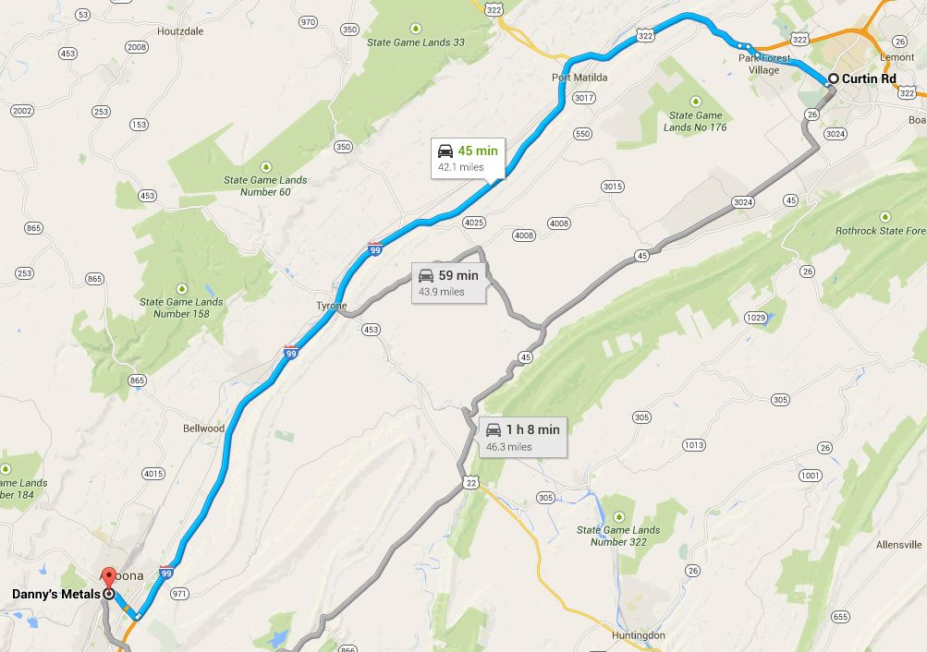
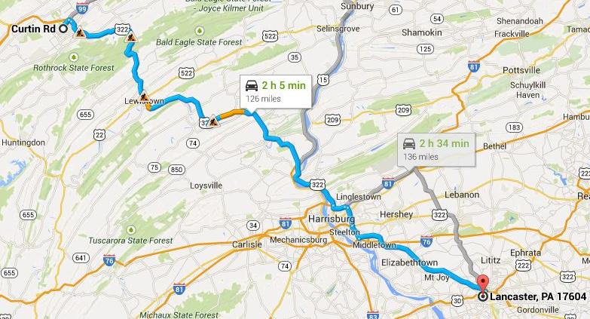
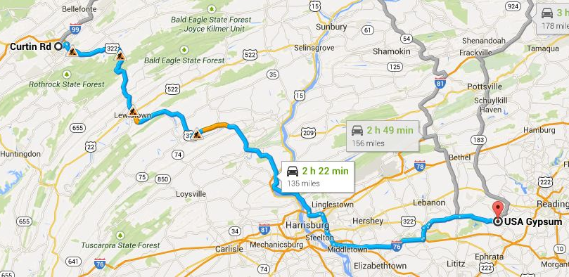
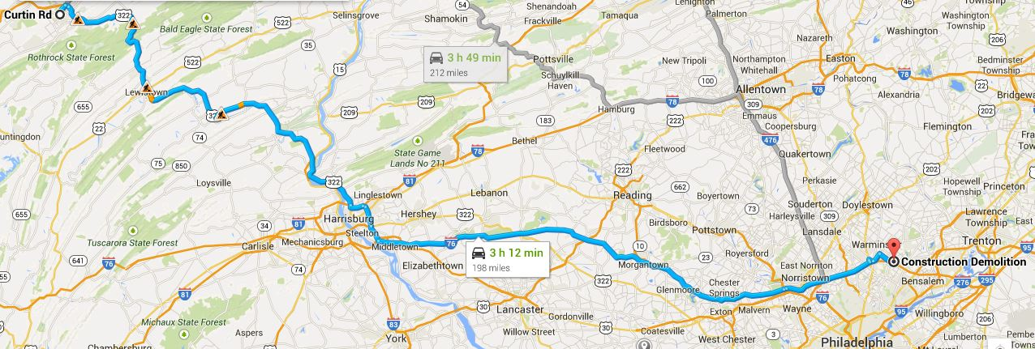
Mueller Laboratory Renovation Presentation Outline: Introduction Breadth topic 1 – Roof Reinforcement Depth topic 1 – Recycling Opportunities Depth topic 2 – Site Logistics Breadth topic 2 – LED Downlights Conclusion
Recycling Opportunities
Altoona, PA
Recycles scrap metals
Offers free pick-up
Pays cash for scrap
42 miles away
Southampton, PA
Offers offsite sorting/recycling
Accepts general construction debris
198 miles away
Lancaster, PA
Recycles new and used ceiling tiles
126 miles away
Reinholds, PA
Recycles new, unpainted gypsum only
No demolition drywall
135 miles away
$$42 miles×\frac{1 gallon}{6 miles}=7 gallons diesel fuel$$
$$198 miles×\frac{1 gallon}{6 miles}=33 gallons diesel fuel$$
$$126 miles×\frac{1 gallon}{6 miles}=21 gallons diesel fuel$$
$$135 miles×\frac{1 gallon}{6 miles}=22.5 gallons diesel fuel$$

Slide 11
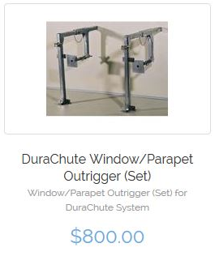
Mueller Laboratory Renovation Presentation Outline: Introduction Breadth topic 1 – Roof Reinforcement Depth topic 1 – Recycling Opportunities Depth topic 2 – Site Logistics Breadth topic 2 – LED Downlights Conclusion
Recycling Opportunities
Break Even Calculations
Trash Chute Rental
Dumpster Rental
$$\$8626 Chute and Dumpster cost$$
$$÷\$0.11 per lb scrap steel$$
=78,418 lbs scraps steel
$10 months ×\frac{4.3 weeks}{1 month}×\frac{\$700}{4 weeks}=\$7525$ total rental cost
9751 lbs duct being installed on 1st floor
$$×3 for 1st, 5th, 6th floor$$
=29,253 lbs scrapped duct weight
Trash Chute Purchase
18700 lbs per AHU
$$×3 being installed$$
=56,100 lbs scrapped AHU weight
$$10 months×\frac{4.3 weeks}{1 month}×\frac{\$13.5}{1 week}=\$580.50$$
$$\$580.50 extra fee$$
$$+\$810.72 base price$$
$$=\$1391.22 total dumpster rental cost$$
29,253 lbs duct weight
$+$56,100 lbs AHUs
=85,353 lbs Mech scrap weight
$${75}^{′}chute ×\frac{12 inches}{1 foot}×\frac{1 section}{31 inches}=29 sections$$
$$29 sections×\frac{\$200}{1 section}=\$5800$$
$$\$5800 chute$$
$$+\$635 hopper$$
$$+\$800 mount$$
$=\$7235 total$purchase cost
$\$1391$dumpster rental
$$+\$7235 trash chute purchase$$
$$=\$8626 Total Cost$$
Results
Mech scrap will pay for dumpster, trash chute
Electrical scrap extra
Plumbing scrap extra

Slide 12
Mueller Laboratory Renovation Presentation Outline: Introduction Breadth topic 1 – Roof Reinforcement Depth topic 1 – Recycling Opportunities Depth topic 2 – Site Logistics Breadth topic 2 – LED Downlights Conclusion
Site Logistics
Legend:
Gate-------------------------
Site fencing----------------
Landscape protection----fencing
Contractor parking-------
Material Staging----------

Slide 13
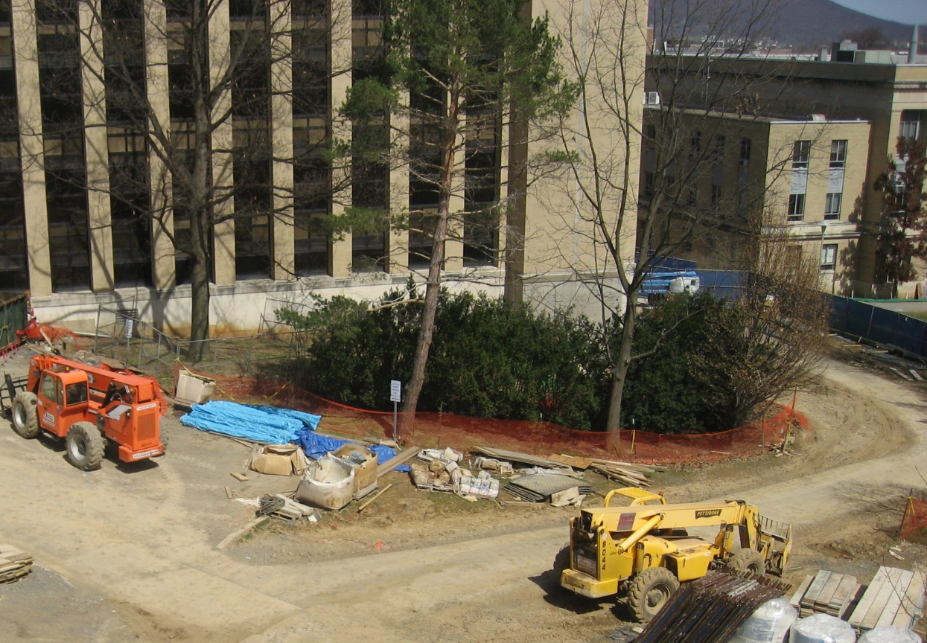
Mueller Laboratory Renovation Presentation Outline: Introduction Breadth topic 1 – Roof Reinforcement Depth topic 1 – Recycling Opportunities Depth topic 2 – Site Logistics Breadth topic 2 – LED Downlights Conclusion
Site Logistics
Legend:
Gate-------------------------
Site fencing----------------
Landscape protection----fencing
Contractor parking-------
Material Staging----------

Slide 14
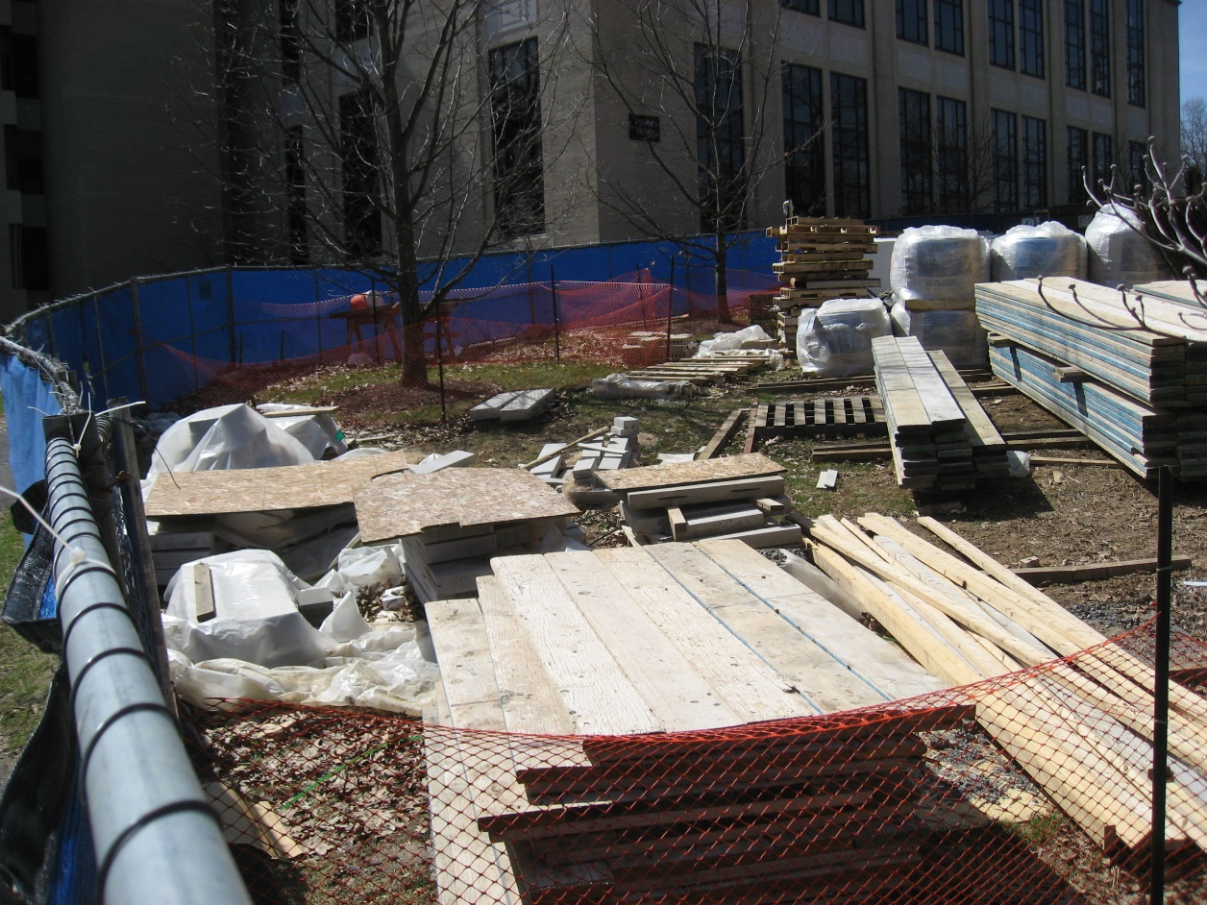
Mueller Laboratory Renovation Presentation Outline: Introduction Breadth topic 1 – Roof Reinforcement Depth topic 1 – Recycling Opportunities Depth topic 2 – Site Logistics Breadth topic 2 – LED Downlights Conclusion
Site Logistics
Legend:
Gate-------------------------
Site fencing----------------
Landscape protection----fencing
Contractor parking-------
Material Staging----------

Slide 15
Mueller Laboratory Renovation Presentation Outline: Introduction Breadth topic 1 – Roof Reinforcement Depth topic 1 – Recycling Opportunities Depth topic 2 – Site Logistics Breadth topic 2 – LED Downlights Conclusion
Site Logistics
Legend:
Gate-------------------------
Site fencing----------------
Landscape protection----fencing
Contractor parking-------
Material Staging----------

Slide 16
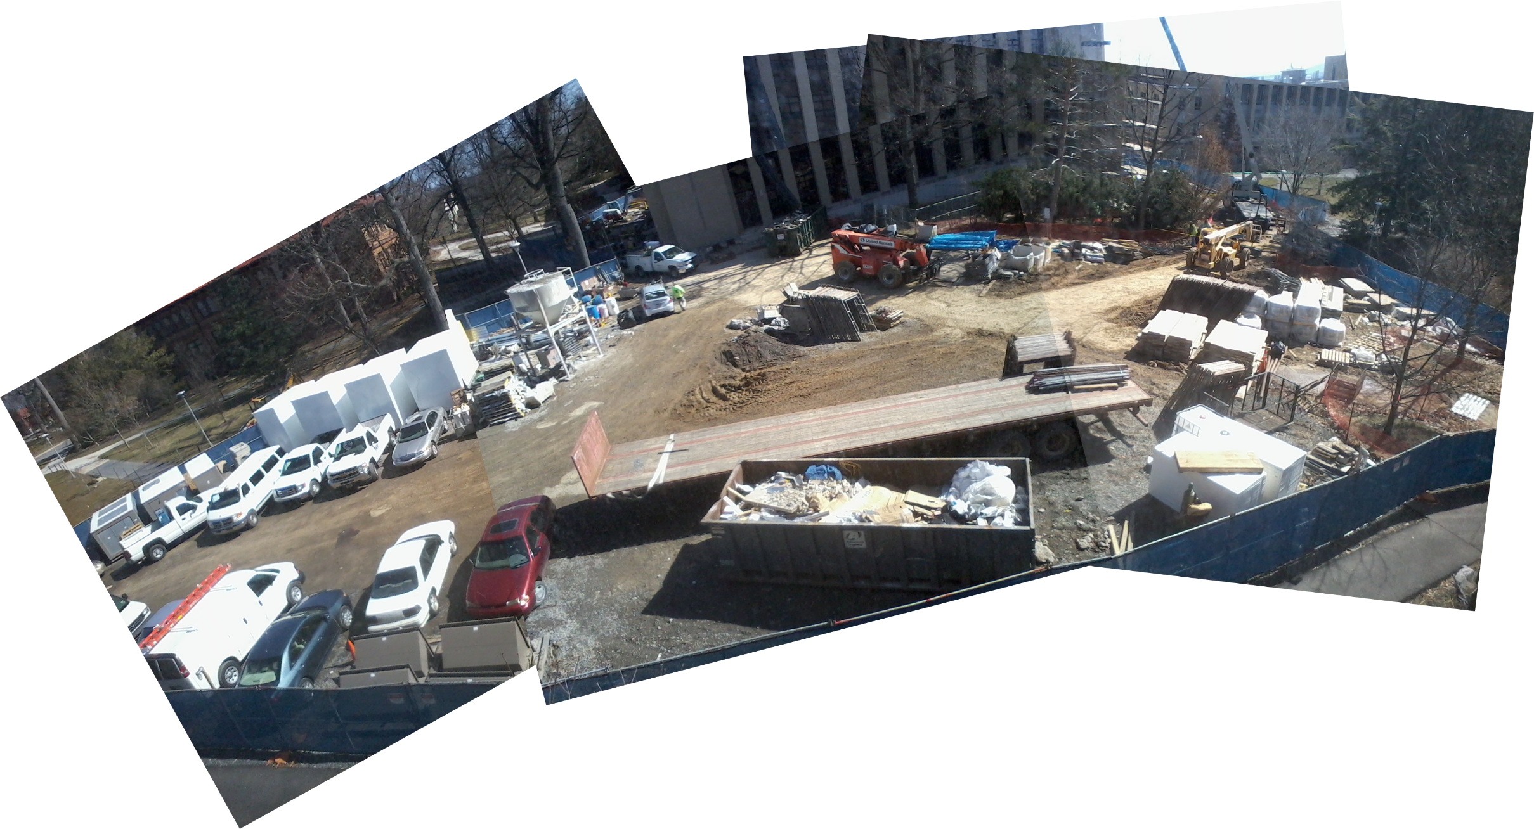
Mueller Laboratory Renovation Presentation Outline: Introduction Breadth topic 1 – Roof Reinforcement Depth topic 1 – Recycling Opportunities Depth topic 2 – Site Logistics Breadth topic 2 – LED Downlights Conclusion
Site Logistics

Slide 17
Mueller Laboratory Renovation Presentation Outline: Introduction Breadth topic 1 – Roof Reinforcement Depth topic 1 – Recycling Opportunities Depth topic 2 – Site Logistics Breadth topic 2 – LED Downlights Conclusion
Site Logistics
Legend:
Gate-------------------------
Site fencing----------------
Landscape protection----fencing
Contractor parking-------
Material Staging----------

Slide 18
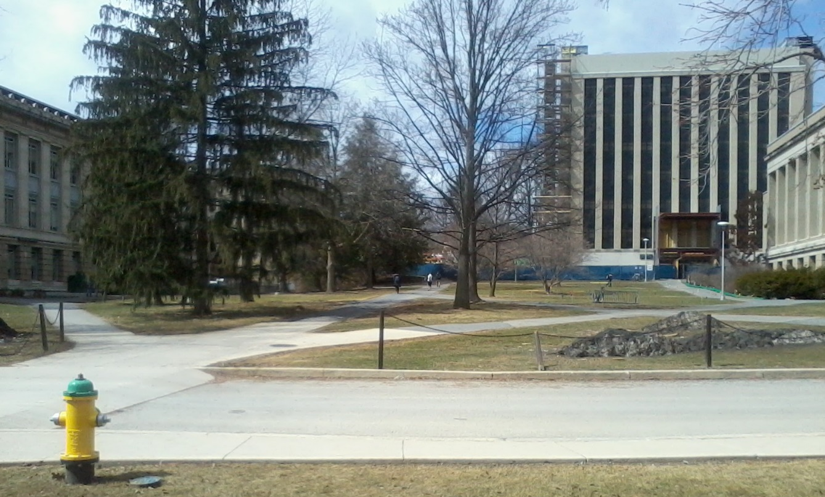
Mueller Laboratory Renovation Presentation Outline: Introduction Breadth topic 1 – Roof Reinforcement Depth topic 1 – Recycling Opportunities Depth topic 2 – Site Logistics Breadth topic 2 – LED Downlights Conclusion
Site Logistics
Legend:
Gate-------------------------
Site fencing----------------
Landscape protection----fencing
Contractor parking-------
Material Staging----------
Proposed Plan
New work site between Whitmore, Pond Labs
Whitmore accessible from south, east, west
Work site access from south, Pollock Road
Hydrant for truck-wash station

Slide 19
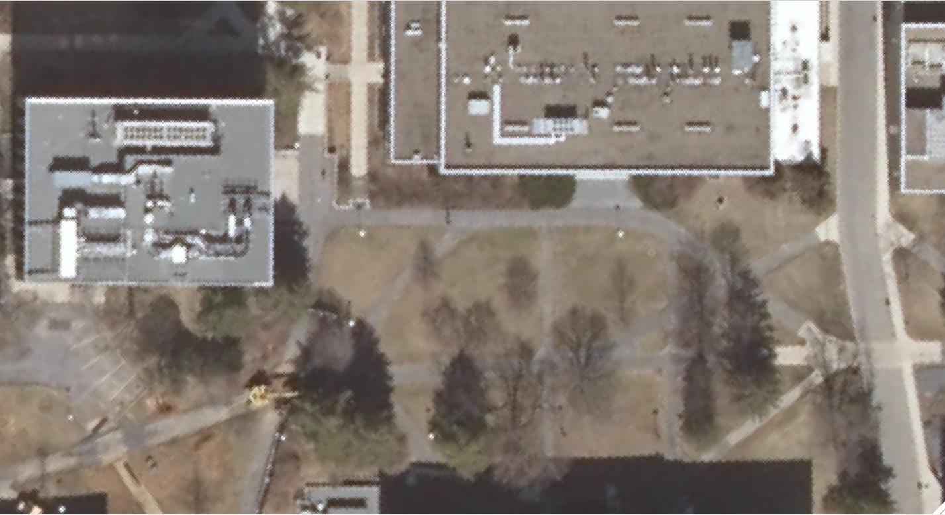
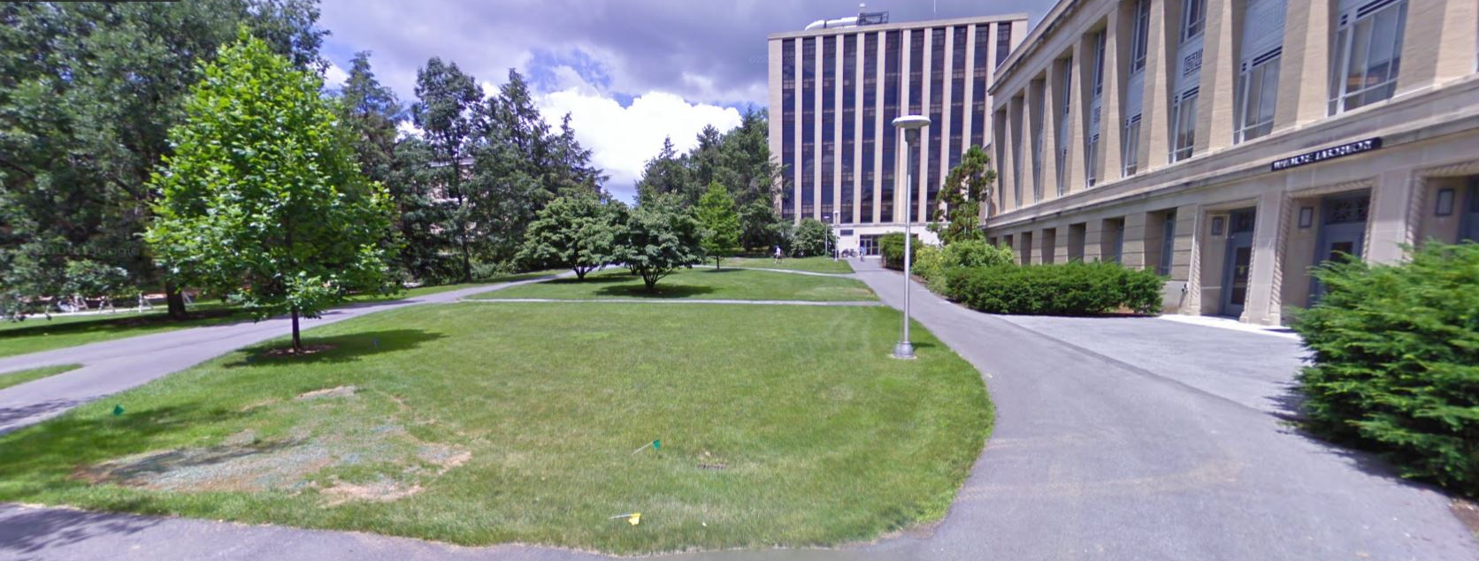
Mueller Laboratory Renovation Presentation Outline: Introduction Breadth topic 1 – Roof Reinforcement Depth topic 1 – Recycling Opportunities Depth topic 2 – Site Logistics Breadth topic 2 – LED Downlights Conclusion
Site Logistics
Proposed Plan
Fewer trees to work around
More contractor parking
More staging area
Flatter staging area
More delivery space
North entrance open for duration of construction
Legend:
Gate-------------------------
Site fencing----------------
Landscape protection----fencing
Contractor vehicles------
Semi trailers--------------
Material staging----------

Slide 20
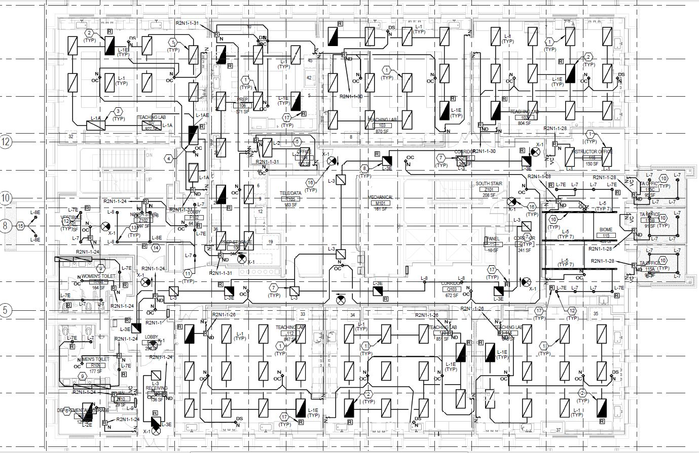
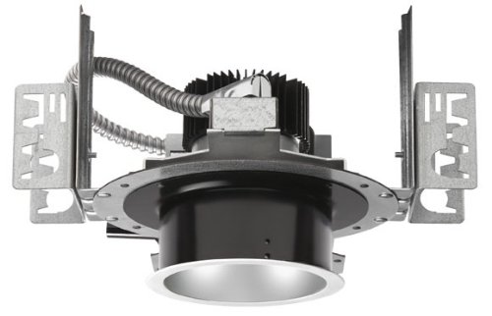
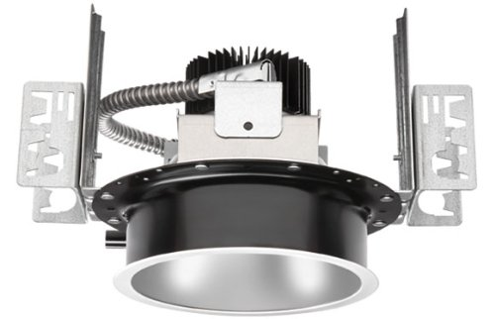
Mueller Laboratory Renovation Presentation Outline: Introduction Breadth topic 1 – Roof Reinforcement Depth topic 1 – Recycling Opportunities Depth topic 2 – Site Logistics Breadth topic 2 – LED Downlights Conclusion
LED Downlights
Current LED Downlight Fixtures
In entryways, lobbies, bathrooms
Not in lab space
60 fixtures total
 | Wattage | Lumens | CRI | CRT
CREE 4” LED fixture | 13 | 665 | 90 | 4000
CREE 6” LED fixture 1 | 18 | 1250 | 90 | 4000
CREE 6” LED fixture 2 | 30 | 1664 | 90 | 4000

Slide 21
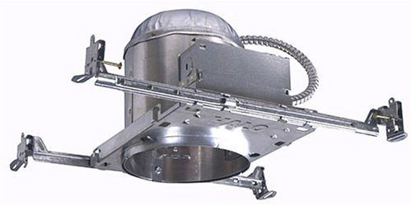
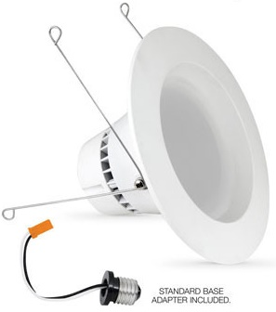
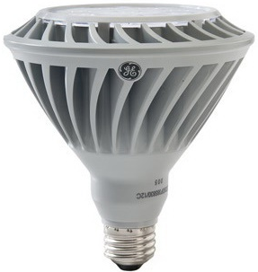
Mueller Laboratory Renovation Presentation Outline: Introduction Breadth topic 1 – Roof Reinforcement Depth topic 1 – Recycling Opportunities Depth topic 2 – Site Logistics Breadth topic 2 – LED Downlights Conclusion
LED Downlights
Proposed LED Downlight Fixtures
Use standard can fixtures
Use screw-in LED bulbs
Match bulb performance to spec’d fixture
 | Fixtures | Cost per fixture | CREE fixture total costs | Cost per screw-in bulb | Screw in bulb total costs | Difference in total costs
CREE 4” | 2 | $157 | $314 | $33 | $66 | $248
CREE 6” #1 | 48 | $157 | $7536 | $36 | $1728 | $5808
CREE 6” #2 | 10 | $204 | $2040 | $69 | $690 | $1350
 |  |  |  | Total amount saved: |  | $7406
 | Wattage | Lumens | CRI | CRT
CREE 4” LED fixture | 13 | 665 | 90 | 4000
CREE 6” LED fixture 1 | 18 | 1250 | 90 | 4000
CREE 6” LED fixture 2 | 30 | 1664 | 90 | 4000
LED bulb 1 | 13 | 700 | 92 | 2700
LED bulb 2 | 20.8 | 1250 | 94 | 2700
LED bulb 3 | 26 | 1650 | 82 | 4000
Advantages of screw-in LED bulbs
Less expensive than hard-wired fixtures
Better performance from screw-in bulbs
Inexpensive maintenance
Can take advantage of technological advances

Slide 22
Mueller Laboratory Renovation Presentation Outline: Introduction Breadth topic 1 – Roof Reinforcement Depth topic 1 – Recycling Opportunities Depth topic 2 – Site Logistics Breadth topic 2 – LED Downlights Conclusion
Conclusion
Recommendations
Move the roof reinforcement to the top of the roof deck.
Scrap metal recycling is economical and easy.
The project’s worksite would benefit greatly from going south, not west.
Screw-in LED bulbs should be used instead of hard-wired LED downlights.
3
2
1
AHU 1
AHU 2
1
2
3
4
5
Posts on beam
AHU 3

Slide 23
Mueller Laboratory Renovation Presentation Outline: Introduction Breadth topic 1 – Roof Reinforcement Depth topic 1 – Recycling Opportunities Depth topic 2 – Site Logistics Breadth topic 2 – LED Downlights Conclusion
Acknowledgements:
Penn State University
Barton Malow
Dr. Riley
PSU AE Department

Slide 24
Mueller Laboratory Renovation Presentation Outline: Introduction Breadth topic 1 – Roof Reinforcement Depth topic 1 – Recycling Opportunities Depth topic 2 – Site Logistics Breadth topic 2 – LED Downlights Conclusion
Questions?

